Slide 1
Risk Management and Adaptation in Extension and Advisory Services
Global Forum for Rural Advisory Services (GFRAS)
Part of the New Extensionist Learning Kit

Slide 2
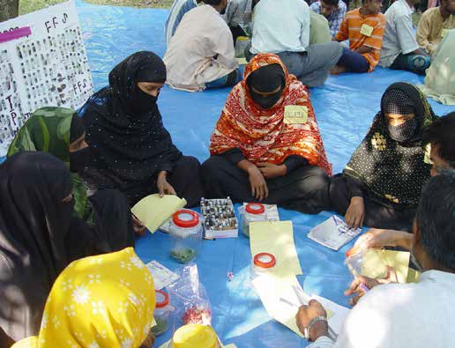
The role of risk and adaptation management
Identifying current and future risk factors
Improving rural farmer resilience to risk
Empowering farmers to manage risk
Assisting farmers in understanding and adapting to the risks of climate change

Slide 3
Introduction to risks, climate science and climate change in Rwandan context
Study unit 1

Slide 4
Overview
Study unit 1 is about:
  Understanding risk and uncertainty
  Identifying different types and sources of risk
  Performing basic risk analysis
  Conducting risk evaluation
  Problem-solving
  Decision-making

Slide 5
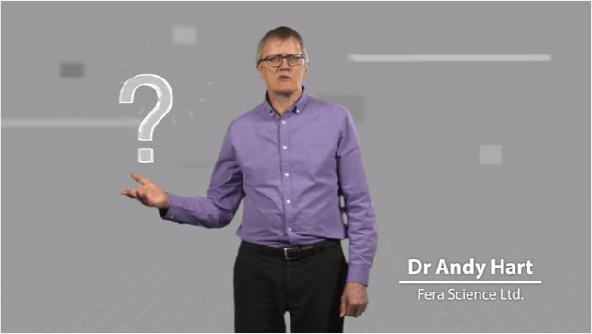
Understanding concept of risk, uncertainty and risk management
The relation between risk and uncertainty

Slide 6
Risk determinants
Hazards
  Negative impacts associated with risks
Risk exposure
  Who is affected?
Vulnerability
  Are they able to deal with these risks?

Slide 7
Vulnerability
Vulnerability determines the level of risk the farmer is under from risk sources. An inability to deal with or adapt to adverse effects.
One of the first steps in extension risk management is gaining the ability to identify which risks the farmer is exposed to and determine their vulnerability to these risks.

Slide 8
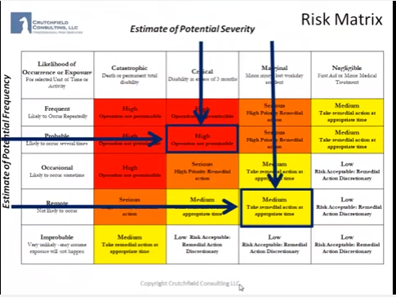
Risk analysis and evaluation
The risk matrix is a powerful tool for analysis and evaluation

Slide 9
Risk evaluation
Risk evaluation requires identifying the severity of risk hazards, the impacts associated with negative outcomes and the likelihood of these negative outcomes occurring.

Slide 10

Risk perception and human behaviour
Risk perception
  Varies between individuals based on:
    Learned knowledge
    Personal experience
    beliefs

Slide 11
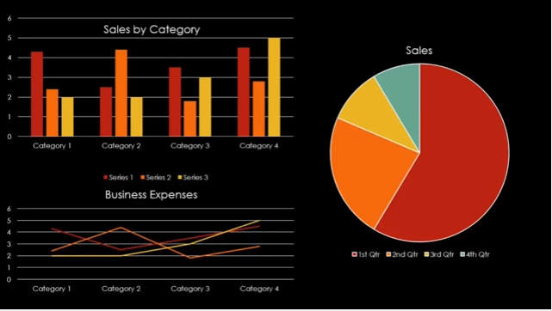
Understanding statistics
Statistics are a powerful tool in evaluating risk and uncertainty

Slide 12
Risk management steps
Step 1: Identification
  Risks are identified based on the exposure and vulnerability of individuals and the context they find themselves in
Step 2: Evaluation
  Identified hazards are measured in terms of their severity and likelihood
Step 3: Assessment and mitigation
  Identified risks are analysed in order to take steps to decrease their likelihood and severity

Slide 13
Adaptation and climate change
Study unit 2 – Part 1

Slide 14
Overview
Study unit 2 – Part 1 is about:
  Adaptation in context
  Community engagement in climate change
  Vulnerabilities to climate change
  Community climate change adaptation plans

Slide 15
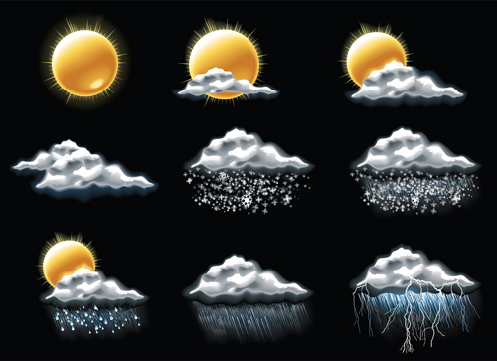
Climate science
Weather
  Atmospheric conditions
  Specific location
  Short term
Examples
  Precipitation, maximum and minimum temperatures, cloud cover, snow

Slide 16
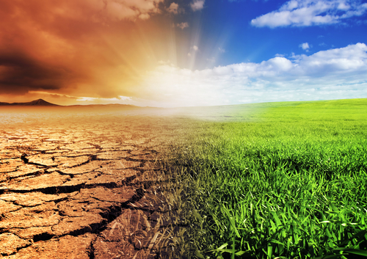
Climate science
Climate
  Large areas
  Medium to long term
  Based on weather data
Examples
  Seasonal changes in weather, droughts
  Long term changes in expected yearly weather patterns

Slide 17
Vulnerability to climate change
Dependent on:
  Magnitude
  Timing
  Persistence and reversibility
  Likelihood and confidence
  Potential for adaptation
  Importance of system at risk

Slide 18
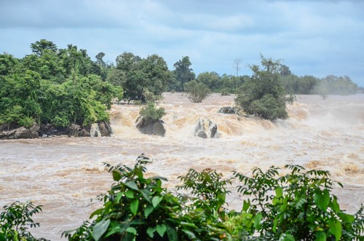
Extreme events
Events which are unexpected, unusual or severe
Examples are:
Flash floods, droughts, cyclones etc.

Slide 19
Climate change and agriculture
Adaptation to climate change is dependent on:
  Access to and development of technology
  Water resources
  Farmers capacity to understand climate change

Slide 20
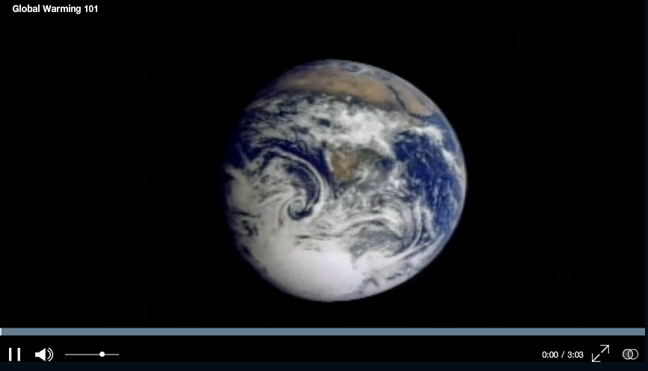
Global warming

Slide 21
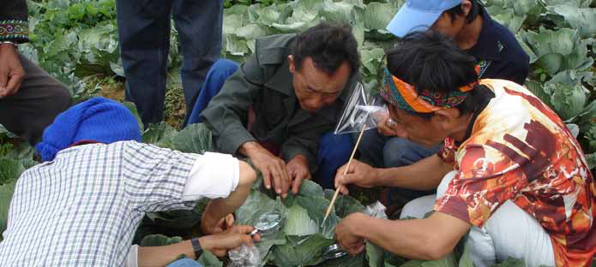
Climate change and socio-economics
Capital
  Determines a group's ability to prepare for, adapt to and recover from climatic events

Slide 22
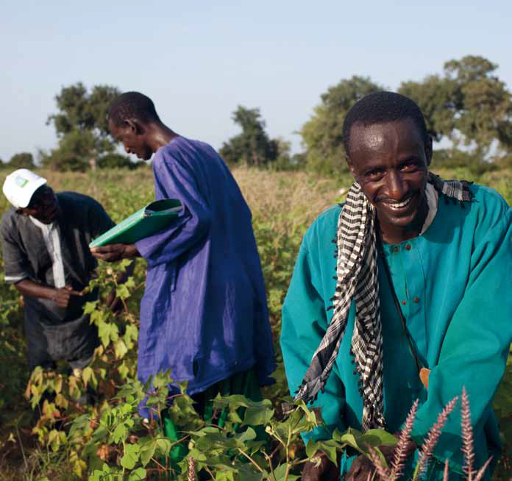
Types of capital
Human capital
Social capital
Natural capital
Physical capital
Financial capital

Slide 23
Climate change and health
Community vulnerability to increased disease burden is dependent on:
  Severity of exposure
  Level of disease burden
  Capacity of the health care system

Slide 24
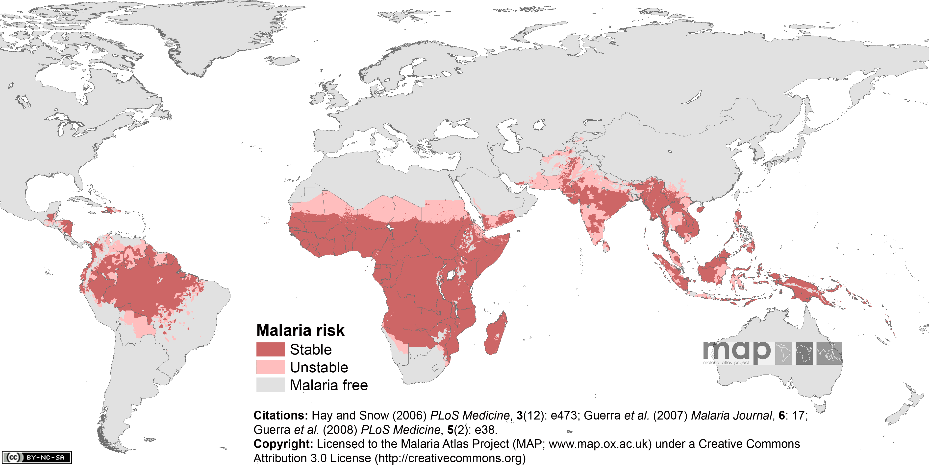
Major risks: Malaria
Increased temperatures expected to result in more favourable mosquito breeding zones

Slide 25
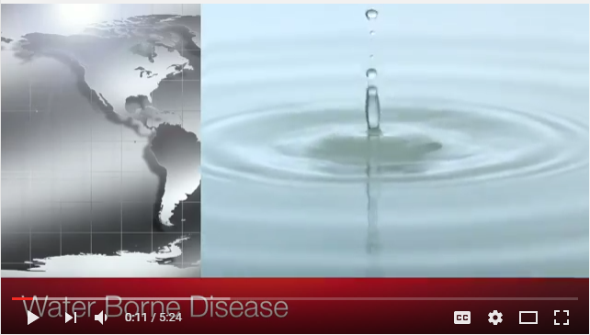
Major risks: Waterborne disease
Increased demands on food and water sources could pose significant risks to rural communities

Slide 26
Adaptation planning and implementation steps
Step 1: Share knowledge
Step 2: Assess climate change risk
Step 3: Promote communication
Step 4: Identify key areas
Step 5: Consolidate approaches

Slide 27
Understanding adaptation and climate smart agriculture (CSA) in Rwanda context.
Study unit 2 – Part 2

Slide 28
Overview
Study unit 2 – Part 2 is about:
  Adaptation in the context of climate change and the factors affecting adaptive capacity of farmers to climate change
  Concept of climate smart agriculture (CSA)
  Components of Climate smart agriculture
  Concept of access and use of climate Information services for agriculture

Slide 29
Adaptation in the context of climate change
Adaptation refers to how you respond to (or prepare for) change within an ecosystem, socioeconomic or political space, in order to reduce the negative impacts and take advantage of opportunities arising from abrupt change.

Slide 30
Factors affecting adaptive capacity of farmers to climate change
The farmer is aware that patterns of weather – the climate – have changed and that she/he needs to adapt.
The farm family has enough people to do the work (family labor) needed to make changes and adopt new farming practices.
The farm family has money and other resources (their assets) to invest in making changes.
The farm family or group has ownership or control over key resources (tenure) necessary to make changes.
Their community is willing to work together to make the necessary changes that improve all of their lives (working together at different scales).
Their community receives government support services, such as extension.
They live in a country that has agricultural policies and strategies to increase national climate change resilience.
Agricultural research and extension services support adaptation, especially for rainfed farming (national systems and structures).
Social and economic systems support fair access to water and land, education, information, financial services and infrastructure.

Slide 31
The concept of Climate Smart Agriculture (CSA)
Climate-smart agriculture (CSA) is an approach for developing actions needed to transform and reorient agricultural systems to effectively support development and ensure food security under climate change.

Slide 32
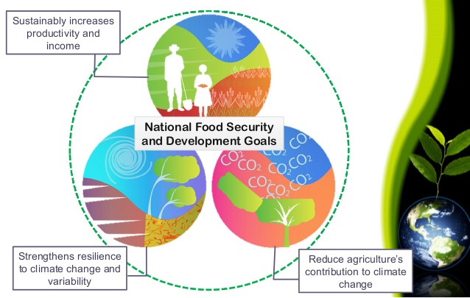
Objectives of climate Smart agriculture
Climate Smart Agriculture aims to tackle three main objectives: sustainably increasing agricultural productivity and incomes; adapting and building resilience to climate change; and reducing and/or removing greenhouse gas emissions, where possible.

Slide 33
Examples of Climate Smart Agriculture practices applicable in Rwanda
Integrated Soil Fertility Mgt (ISFM)
Conservation agriculture
Agro-forestry systems
Sustainable management of Pests & diseases
Crop diversification

Slide 34
Climate Smart Agriculture best practices and technologies for smallholder farmers
Most farmers in Rwanda lack adequate knowledge of climate-smart agriculture and sustainable environmental practices, which further increases their vulnerability, as well as the risks to agriculture and the environment.

Slide 35

Climate information services
Climate information services cover the whole process of obtaining climate data, storing it, and processing it into specific products that are required by different users in climate -sensitive sectors such as agriculture, disaster-risk reduction and health, among others.

Slide 36
Contribution of climate information services
The following are the contribution that climate information makes to Climate Smart Agriculture:
  Productivity
  Adaptation through risk management
  Mitigation

Slide 37
Agriculture Extension and advisory services for climate smart agriculture
Study unit 3

Slide 38
Overview
Study unit 3 is about:
  Understanding the role of EAS in risk assessment and adaptation planning
  Sharing best practices on risk assessment and adaptation planning

Slide 39
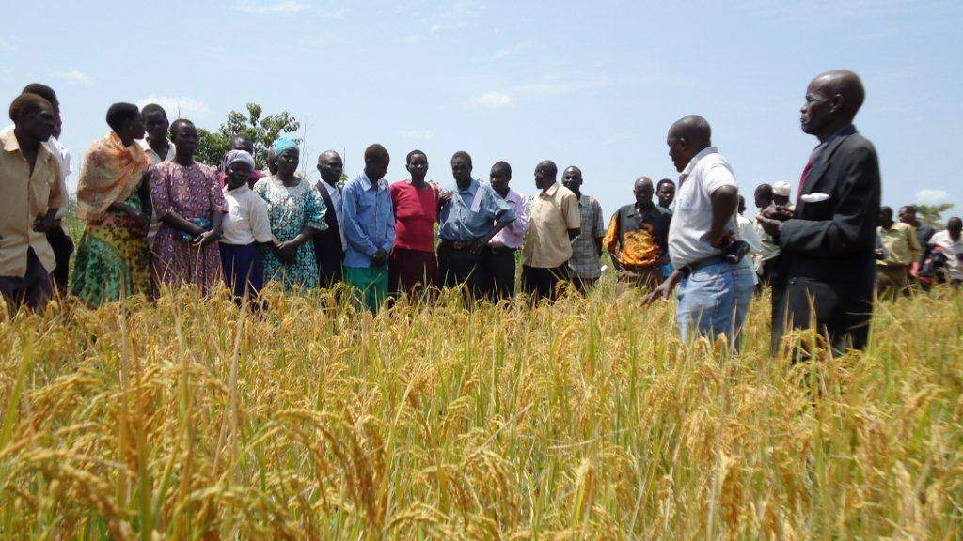
EAS in mitigating risk and uncertainty
At a farmer level EAS is involved in:
  Communicating risk
  Communicating adaptation measures
  Training on how to best mitigate risk

Slide 40
Risks faced by farmers
Changes in soil and water conditions due to climate change
Climate change impact on seasonality of planting and harvesting
Price and market uncertainty
Increases in pest and disease levels
Extreme events

Slide 41
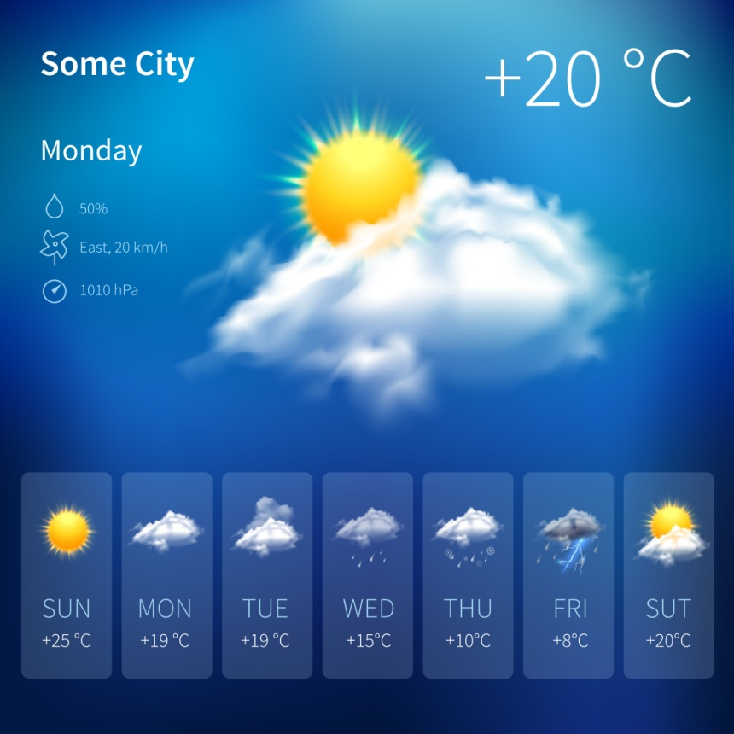
Climate forecasts
Climate predictions include both short and long term predictions of atmospheric and oceanic conditions
  Short-term predictions known as weather forecasts

Slide 42
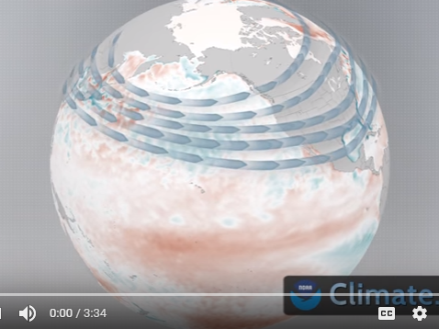
Climate prediction example
The following video outlines a long-term forecast from the NOAA’s climate prediction centre

Slide 43

Market forecasts
Provide long-term predictions for:
  Crop prices
  Consumer demand/preferences
  Competition

Slide 44
Best practices
  Adopting water and energy efficient practices
  Developing local market systems
      Improving market access
      Understanding how markets operate
    Adopting new farming practices and crop types
      Improving disease resistance
      Decreasing vulnerability to crop price fluctuation

Slide 45
Gender and other adaptive options to Climate change
Study unit 4

Slide 46
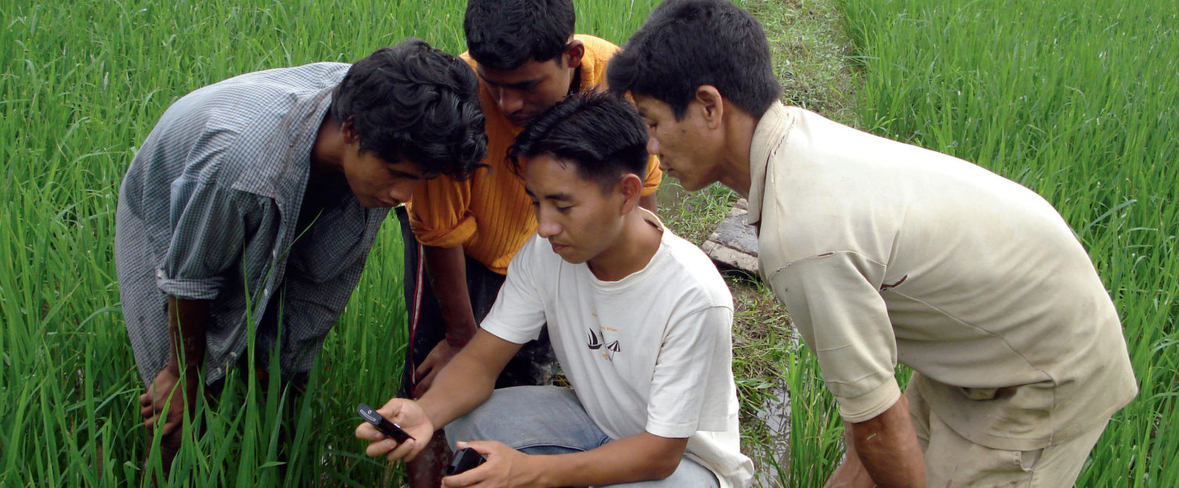
Overview
Study unit 4 is about:
  Understanding adaptive options to climate change by considering gender as a cross cutting option in terms of addressing issues and challenges related to climate change

Slide 47

What is gender?
Gender refers to the socially constructed characteristics of women and men, such as norms, roles, and relationships of and between groups of women and men.
It varies from society to society and can be changed.
Climate change is adversely impacting the lives and livelihoods of women and men, their families and communities across Rwanda.

Slide 48
Gender mainstreaming in Climate smart agriculture
Mainstreaming a gender perspective is the process of assessing the implications for women and men of any planned action, including legislation, policies or programmes, in any area and at all levels.

Slide 49
Impact of Climate change on gender
Climate change impacts men and women differently, given their different roles and responsibilities at the household and community levels.
Women are more exposed and vulnerable to climate change because they are often poorer, receive less education, and are not involved in political and household decision-making processes that affect their lives.

Slide 50
Gender equality in the three pillars of Climate smart agriculture
Pillar 1: Sustainably increase agricultural productivity and incomes
Pillar 2: Adapt to and build resilience to climate change
Pillar 3: Reduce and / or remove greenhouse gas emissions, where possible.

Slide 51
Common extreme events and their adoption strategies
Adaptation to drought
Flooding

Slide 52
Monitoring the implementation of Climate Smart Agriculture practices
Monitoring and evaluation are core management tools for climate-smart agriculture. Monitoring and evaluation activities, which are integral parts of the planning and implementation of climate-smart agriculture interventions, set baselines, define indicators, measure progress and evaluate successes and setbacks.

Slide 53
Defining monitoring and evaluation for climate-smart agriculture
The overall goal of assessments, and monitoring and evaluation activities is to effectively guide the transition of sound climate-smart agriculture policies into climate-smart agriculture programmes that are successfully implemented on the ground.
Climate change is likely to have the most severe impacts on groups that are already coping with food insecurity and vulnerable to shocks. Interventions must focus on understanding and addressing the needs and aspirations of these groups and ensure that they are included in decision-making processes.

Slide 54
Common outputs, outcomes and impacts
Poverty and household impacts (where possible this data should be disaggregated by gender or by male- and female-headed households)
Outcomes in terms of climate-smart agriculture-related changes in productivity
Outputs and outcomes indicators related to capacity-development and service-related interventions

Slide 55

Acknowledgements
This module was made possible through the support of the Deutsche Gesellschaft für Internationale Zusammenarbeit (GIZ).
The contents of this module are the responsibility of the authors and do not necessarily reflect the views of GIZ or their government.
All work by Global Forum for Rural Advisory Services is licensed under a CC BY-NC 3.0 Unported License.

